Slide 1
ENHANCE THE PERFORMANCE OF WIRELESS SENSOR NETWORK USING ATTACK DETECTION SYSTEM
GUIDED BY BATCH MEMBERS
Dr.S.G.SUSILA NARMIDHA.M - 810020106058
PARKAVI.P - 810020106061
REVATHY.B - 810020106075

Slide 2
OBJECTIVE
This project is to evaluate the performance of WSN by Attack detection system through simulation tests.

Slide 3
BASE PAPER
Stochastic Gradient Descent Intrusions Detection for Wireless Sensor Network Attack Detection System Using Machine Learning
Saleh HM, Marouane H, Fakhfakh A. Stochastic Gradient Descent Intrusions Detection for Wireless Sensor Network Attack Detection System Using Machine Learning. IEEE Access. 2024 Jan 2.

Slide 4
INTRODUCTION
In WSN, during transmission attacks will occur.
Malicious node will snoops the data.
Here, we have used different protocols to detect the attack considering the energy and time.

Slide 5
LITERATURE SURVEY

Slide 6
TITLE | AUTHOR & YEAR | DESCRIPTION | ADVANTAGES | DISADVANTAGES
RDCM: AN EFFICIENT REAL-TIME DATA COLLECTION MODEL FOR IOT/WSN EDGE WITH MULTIVARIATE SENSORS | Nayef Abdulwahab Mohammed Alduais 2019 | An efficient real-time data collection model for multivariate sensors in IoT/WSN applications named RDCM | RDCM has a very high performance in terms of energy consumption | WSN sensor boards are less reliable when the error rate is close to zero
DESIGN AND ANALYSIS OF A PERSISTENT, EFFICIENT, AND SELF-CONTAINED WSN DATA COLLECTION SYSTEM | Wei Zhang , Jianfei Chang 2019 | The Random Feedback Digestion (RFDG) model to remove the symbols and reduce resource consumption by using the feedback information. | In data collection efficiency and reduce the delayed effect | Increase the burden of feedback messages, and also increase the total energy consumption of the network.

Slide 7
TITLE | AUTHOR & YEAR | DESCRIPTION | ADVANTAGES | DISADVANTAGES
ADDING DUTY CYCLE ONLY IN CONNECTED DOMINATING SETS FOR ENERGY EFFICIENT AND FAST DATA COLLECTION | Weiwei Shi, Wei Liu 2019 | An Adding Duty Cycle Only in Connected Dominating Sets approach is proposed, which can effectively reduce network energy consumption and delay. | Effectively reduce energy consumption and delay | ADCOCDS scheme has a good theoretical significance , not in practical as an effective data collection strategy.
EFFICIENT ALGORITHMS FOR MOBILE SINK AIDED DATA COLLECTION FROM DEDICATED AND VIRTUAL AGGREGATION NODES IN ENERGY HARVESTING WSN | Lei Tao Weifa Liang 2019 | The mobile data collection problem in an energy harvesting wireless sensor network (EH-WSN), where sensor nodes are densely deployed in a monitoring area and a mobile sink | Deal with the reliable, stable, and energy neutral energy assignment for sensors. | Less efficient in dynamic optimization algorithm for mobile sink movement.

Slide 8
TITLE | AUTHOR & YEAR | DESCRIPTION | ADVANTAGES | DISADVANTAGES
SUSTAINABLE AND EFFICIENT DATA COLLECTION FROM WSNS TO CLOUD | Tian Wang, Yang Li 2019 | WSNs to cloud within a limited time and this problem is proved to be NP-hard. To reduce the delivery latency caused by unreasonable task allocation. | WSNs to Cloud which makes the sensor-cloud sustainable. | WSNs to Cloud within the limited latency and optimize the energy consumption
BIG DATA CHALLENGES AND DATA AGGREGATION STRATEGIES IN WIRELESS SENSOR NETWORKS | E. Boubiche A. Bilami 2018 | This paper proposed the distributed compressive data aggregation in large-scale wireless sensor networks | Better energy efficient clustering, processing, and securing | Less efficient and not suitable for heterogeneous wireless sensor networks

Slide 9
METRICS TO BE OBTAINED
METRICS | QUALITATIVE | QUANTITATIVE
Throughput | Represents the efficiency of data transmission. | Measured in packets per second (pps).
Packet Delivery Ratio | Indicates the effectiveness of data delivery. | Calculated as the ratio of successfully received packets to the total number of packets sent.
Packet Drop Ratio | Reflects the rate of packet loss or inefficiency in data transmission. | Calculated as the ratio of dropped packets to the total number of packets sent.
Delay | Represents the time taken for data to travel from source to destination. | Measured in milliseconds (ms), indicating the time elapsed between the initiation of transmission and the actual reception.
Energy Consumption | Indicates the amount of energy required for data transmission. | Measured in joules, reflecting the energy expended during packet transmission.

Slide 10
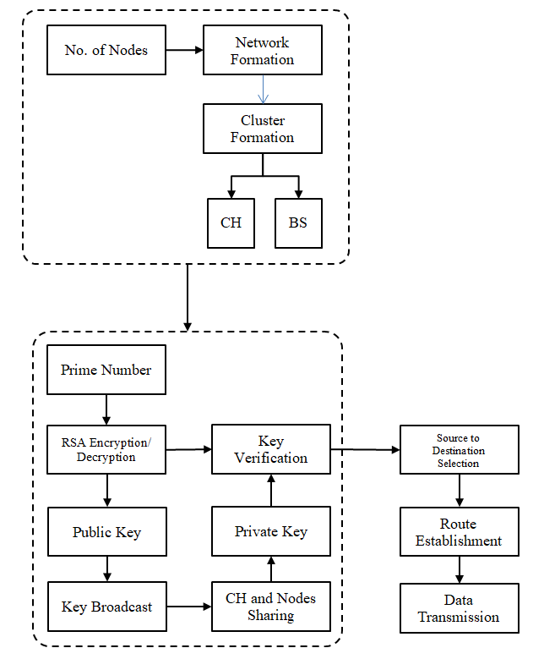
BLOCK DIAGRAM

Slide 11
SET STRUCTURE
Source Node
Proposed Key Management
Public and Private Key Generation
RSA Based Master Key Generation
Check the Key
Invalid
Valid
No Transmission
Destination Node

Slide 12
SET PROTOCOL ALGORITHM
In SET Protocol algorithm, the total energy expenditure involved during data transmission is determined based on the two parameters :
The number of transmissions - considering the source node and all intermediate nodes.
The number of receptions - considering the intermediate nodes and the destination node.

Slide 13
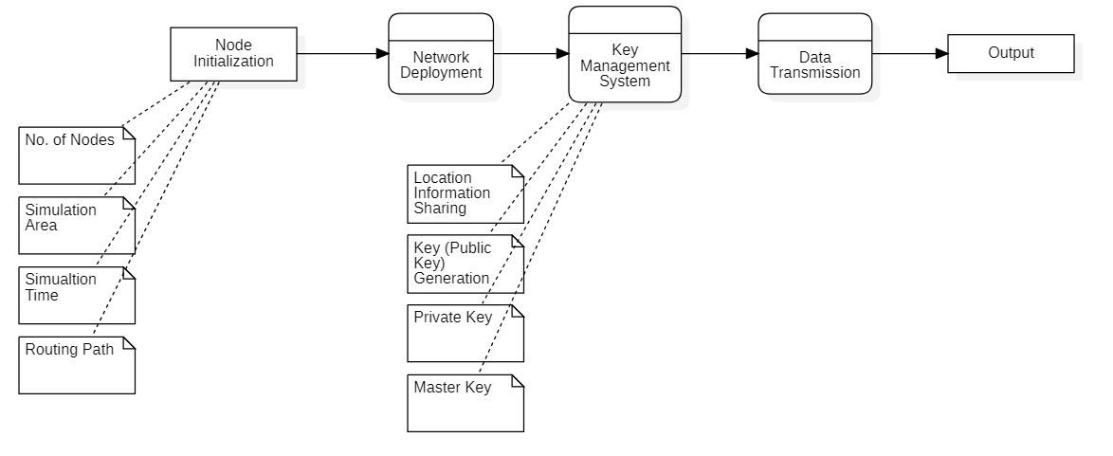
KEY DISTRIBUTION

Slide 14
KEY DISTRIBUTION
The proposed scheme implemented for MANETs consists of the following operations, specifically, setup at the source, key extraction and signature signing at the data sending nodes, and verification at the data receiving nodes:
Setup: The Source(as a trust authority) generates a master key and public parameters for the private key generator (PKG), and gives them to all sensor nodes.
Extraction: Given an ID string, a sensor node generates a private key associated with the ID using master key.
Signature signing: Given a message, time stamp and a signing key, the sending node generates a signature.
Verification: Given the ID, Message, and Signature, the receiving node outputs “accept” if Signature is valid, and outputs “reject” otherwise.

Slide 15
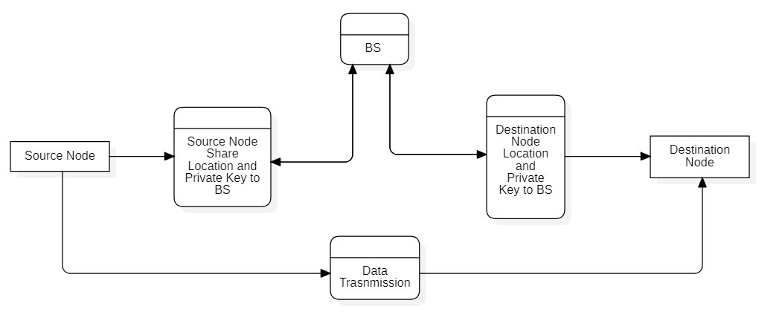
DATA TRANSMISSION

Slide 16
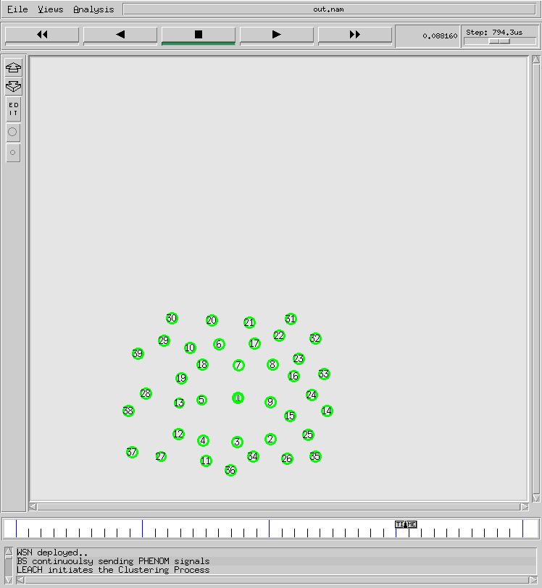
WSN DEPLOYED

Slide 17
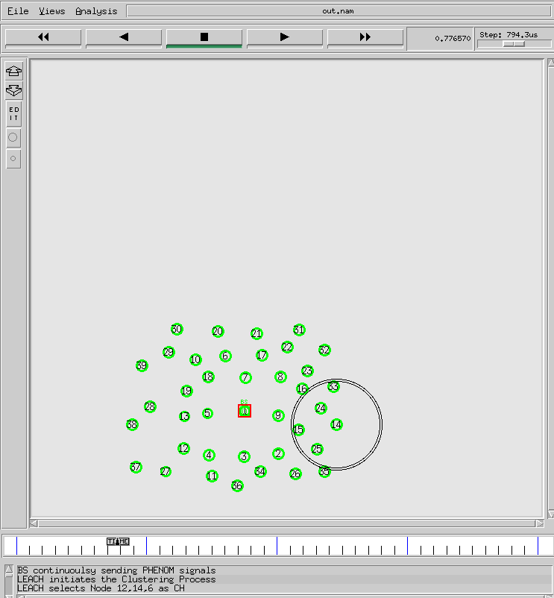
CLUSTERING PROCESS INITIATED

Slide 18
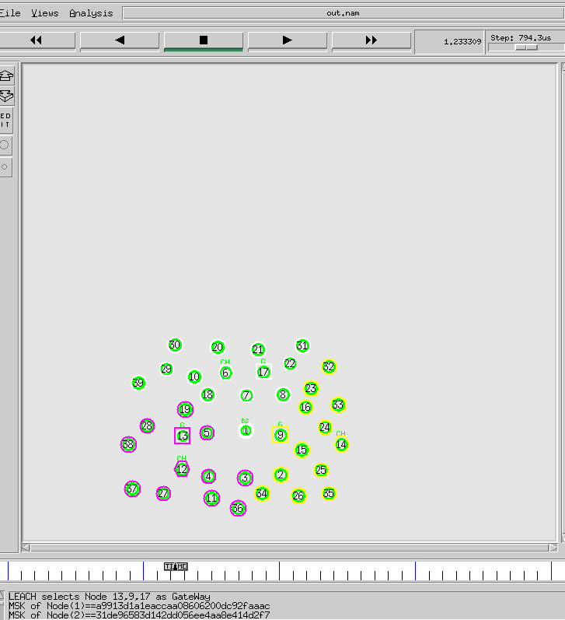
CLUSTER HEADS ARE SELECTED

Slide 19
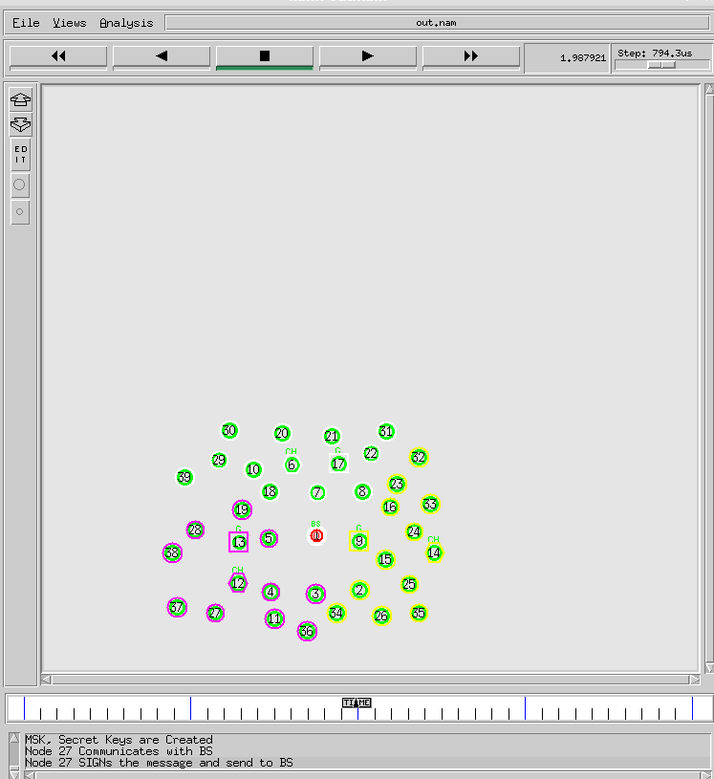
SECRET KEYS GENERATED

Slide 20
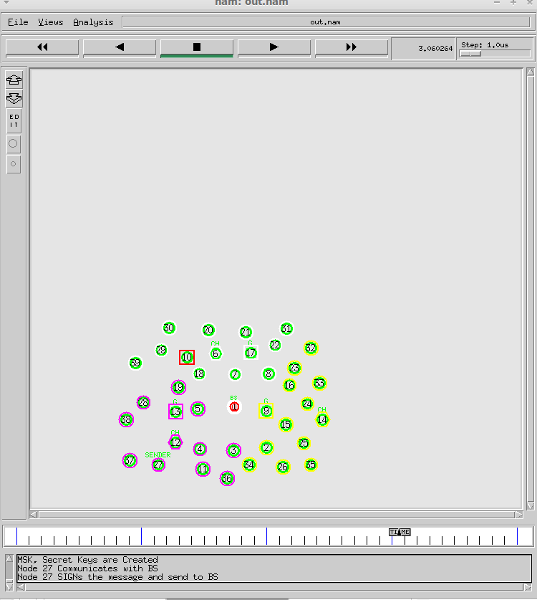
OUTPUT
The proposed energy-balanced routing protocol, in which the packets move toward the source through dense energy area and thus protect the nodes with relatively low residual energy.

Slide 21
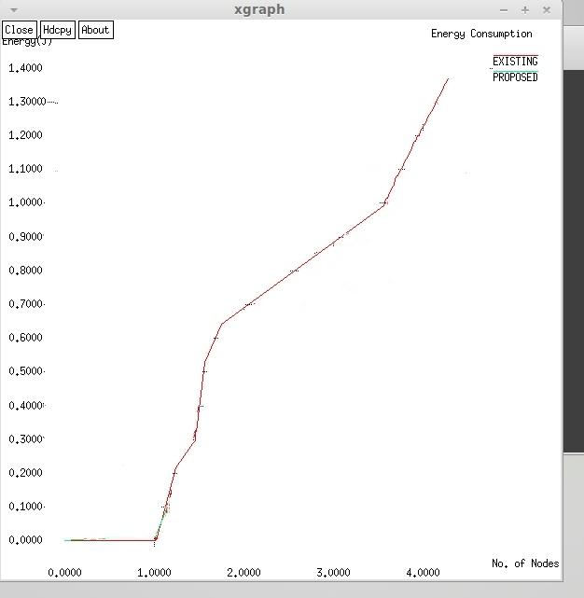
OUTPUT GRAPH- ENERGY CONSUMPTION EXISTING

Slide 22
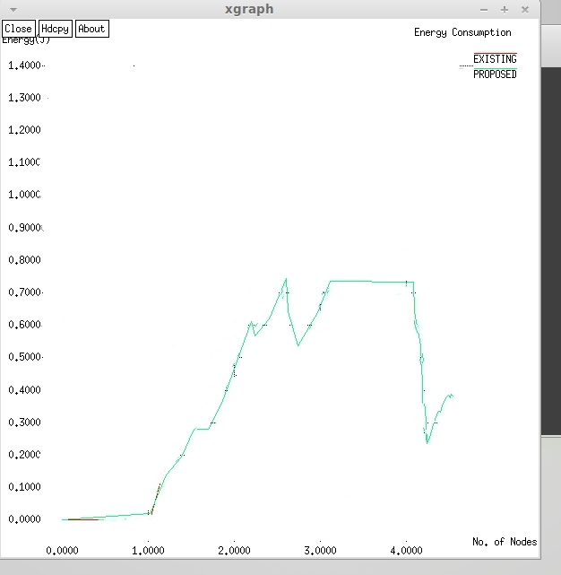
OUTPUT GRAPH- ENERGY CONSUMPTION PROPOSED

Slide 23
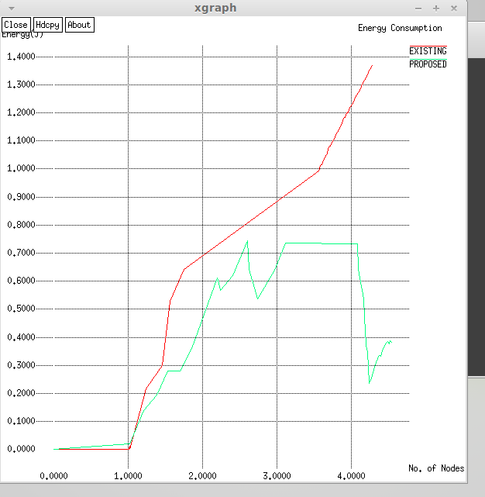
COMPARISON- ENERGY CONSUMPTION
The proposed SET protocol in comparison with Existing solutions in terms of energy utilization. It is seen from experimental results that SET protocol increases the performance of network lifetime

Slide 24
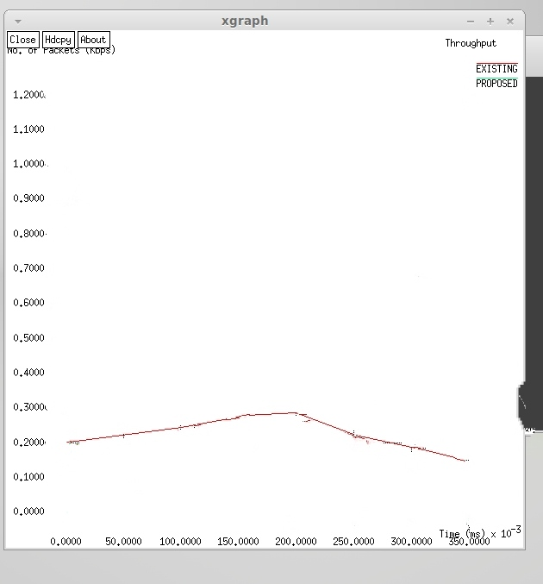
OUTPUT GRAPH- THROUGHPUT EXISTING

Slide 25
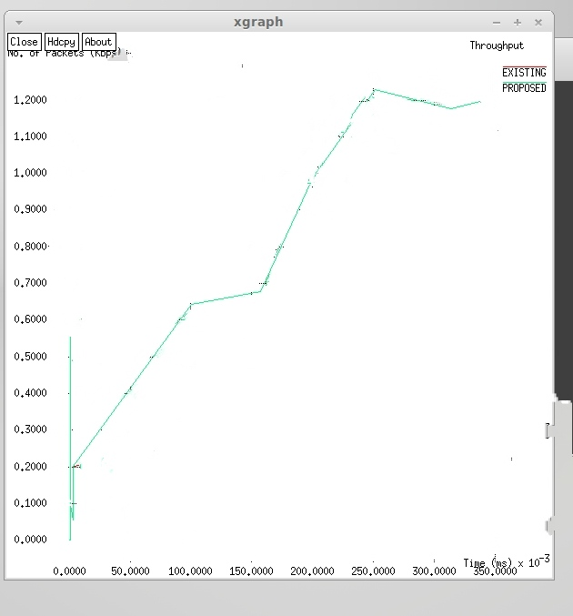
OUTPUT GRAPH- THROUGHPUT PROPOSED

Slide 26
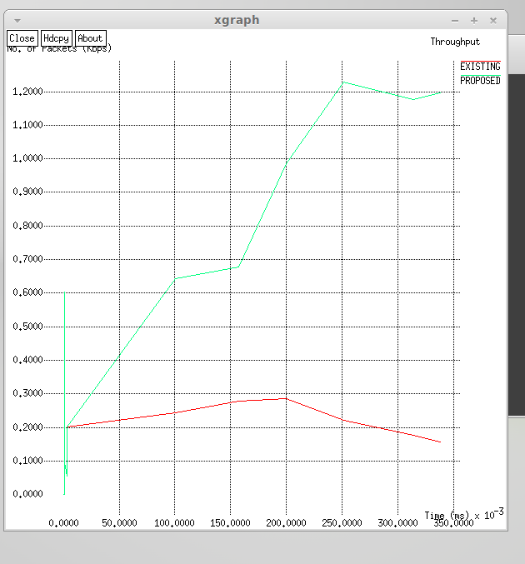
COMPARISON- THROUGHPUT
By exploring experimental outcomes, it is seen that the network throughput of SET carries a noteworthy influence on the routing protocol performance. It may also be noticed that SET made an average of 34% improvement in the network throughput in the evaluation with other solutions.

Slide 27
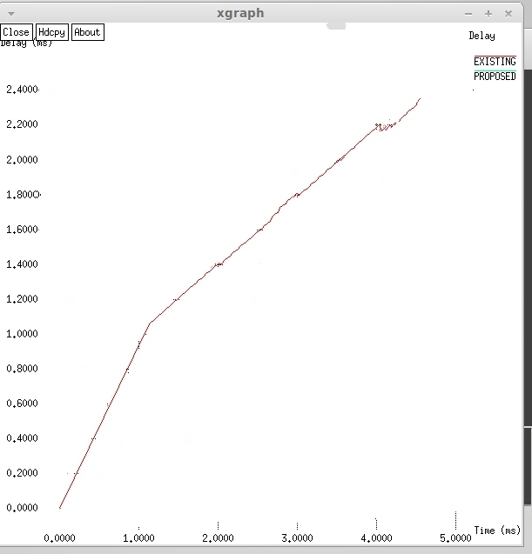
OUTPUT GRAPH- DELAY EXISTING

Slide 28
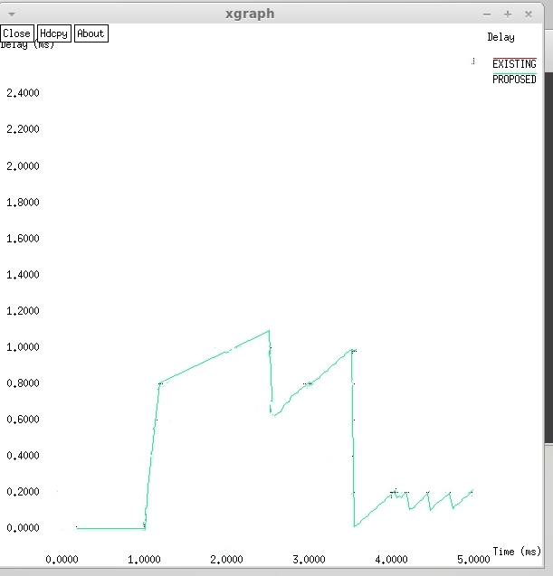
OUTPUT GRAPH- DELAY PROPOSED

Slide 29
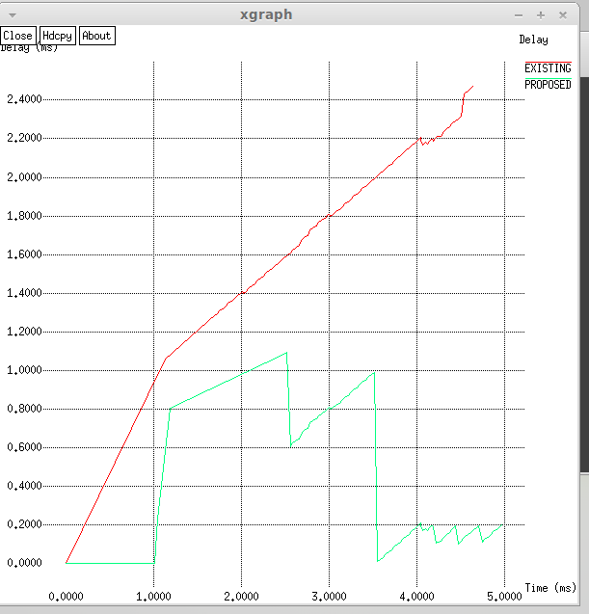
COMPARISON- DELAY
SET's advantage lies in its ability to choose optimal forwarders and shorter routing paths, which reduces the likelihood of packet loss and minimizes end-to-end delay compared to traditional AODV solutions.

Slide 30
RESULT ANALYSIS
The ratio of data packets successfully delivered to destination nodes out of all the unique messages created.
In this module, the performance of the proposed energy and attack method is analyzed.

Slide 31
SYSTEM REQUIREMENTS
Operating System : Windows 10 & Virtual Linux OS
Tool and Language : NS2/TCL
Processor : Any Intel or AMD x86/x64 processor
RAM : 2GB recommended
Disk Space : 3–4 GB for a MATLAB typical installation
Graphics : No specific graphics card is required.

Slide 32
REFERENCES
S. Boubiche, D. E. Boubiche, A. Bilami, and H. Toral-Cruz, “Big data challenges and data aggregation strategies in wireless sensor networks,” IEEE Access, vol. 6, pp. 20558–20571, 2018.
A. De Bonis and U. Vaccaro, “-almost selectors and their applications to multiple-access communication,” IEEE Trans. Inf. Theory, vol. 63, no. 11, pp. 7304–7319, Nov. 2017.
C. Aksoylar, G. K. Atia, and V. Saligrama, “Sparse signal processing with linear and nonlinear observations: A unified Shannon-theoretic approach,” IEEE Trans. Inf. Theory, vol. 63, no. 2, pp. 749–776, Feb. 2017
C.-J. Liu, P. Huang, and L. Xiao, “TAS-MAC: A traffic-adaptive synchronous MAC protocol for wireless sensor networks,” ACM Trans. Sensor Netw., vol. 12, no. 1, p. 1, 2016.
S. Wu, S. Wei, Y. Wang, R. Vaidyanathan, and J. Yuan, “Partition information and its transmission over boolean multi-access channels,” IEEE Trans. Inf. Theory, vol. 61, no. 2, pp. 1010–1027, Feb. 2015.

Slide 33
THANK YOU

